Slide 1
“PITCHING RESEARCH in Entrepreneurship Education” IC4RS Lightning Masterclass Danube Cup 2023
Professor Robert Faff
Bond University & University of Qld

Slide 2
Talk Plan …
PRF – quick primer
An example in entrepreneurship education
… leveraging PRF to your advantage!

Slide 3
GOAL #1
Pitching Research Framework (PRF) …

Slide 5
A Simple tool: A methodical mindset
FOUR | Four Big Picture Anchors
(A) Working Title
(B) Basic Research Question
(C) Key paper(s)
(D) Motivation/Puzzle
THREE | Three essential Building Blocks
(E) Idea?
(F) Data?
(G) Tools?
TWO | Two key questions
(H) What’s New?
(I) So What?
ONE | One bottom line
(J) Contribution?
(K) Other Considerations

Slide 6
… “spoiler alert” …!
…using the PRF is NOT a “form –filling” exercise!

Slide 7
… a catch cry … PRF
“… connecting emerging scholars with research mentors”

Slide 8
You have 1,000 words ± 20% (2 pages)
5 golden rules => make your chosen 1,000 words:
Clear - focused & to the point
Meaningful
Effort-based
Connected internally
Start a conversation (i.e. communication!)

Slide 9
… “drilling down” into the PRF
Topic/ PRF Item | SSRN Paper | Link
Main SSRN paper | Faff (2021) | http://ssrn.com/abstract=2462059
FOUR |  | Four Big Picture Anchors
(A) Working Title | Faff (2022a) | https://ssrn.com/abstract=4273372
(B) Basic Research Question | Faff (2022b) | https://ssrn.com/abstract=4288308
(C) Key paper(s) | Faff (2022c) | https://ssrn.com/abstract=4304511
(D) Motivation/Puzzle | Faff (2023a) | https://ssrn.com/abstract=4327781
THREE |  | Three essential Building Blocks
(E) Idea? | Faff (2023b) | https://ssrn.com/abstract=4337033
(F) Data? | Faff (2023c) | https://ssrn.com/abstract=4327781
(G) Tools? | Faff (2023d) | https://ssrn.com/abstract=4560743
TWO |  | Two key questions
(H) What’s New? | Faff (2023e) | https://ssrn.com/abstract=4568067
(I) So What? | Faff (2023f) | https://ssrn.com/abstract=4570139
ONE |  | One bottom line
(J) Contribution? | Faff (2022d) | https://ssrn.com/abstract=4073797
(K) Other Considerations | Faff (2022g) | https://ssrn.com/abstract=4571893

Slide 10
GOAL #2
An example in entrepreneurship education …

Slide 11
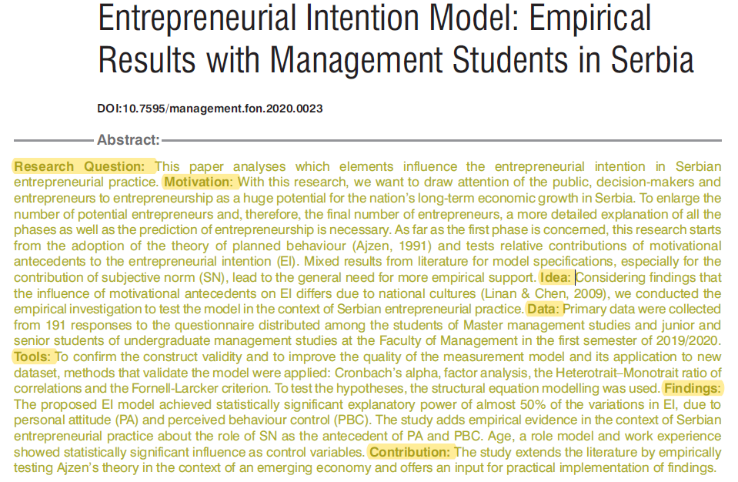

Slide 12
Full Reference:
Tosovic, M., and Jovanovic, V., (2021), “Entrepreneurial Intention Model: Empirical Results with Management Students in Serbia”, Management: Journal of Sustainable Business and Management Solutions in Emerging Economies 26(2), 15-28.
(B) Research Question: This paper analyses which elements influence the entrepreneurial intention in Serbian entrepreneurial practice.

Slide 13
(C) Key Papers (derived separately from Abstract):

Slide 14
(C) Key Papers:
Ajzen, I. (1991). The theory of planned behaviour. Organizational behaviour and human decision processes, 50 (2), 179-211.
Veciana, J. M., Aponte, M., & Urbano, D. (2005). University students’ attitudes towards entrepreneurship: A two countries comparison. The International Entrepreneurship and Management Journal, 1 (2), 165-182.
Linan, F., & Chen, Y. W. (2006). Testing the entrepreneurial intention model on a two-country sample. (Working Papers 0607), Departament Empresa, Universitat Autonoma de Barcelona.

Slide 15
(D) Motivation: With this research, we want to draw attention of the public, decision-makers and entrepreneurs to entrepreneurship as a huge potential for the nation’s long-term economic growth in Serbia. To enlarge the number of potential entrepreneurs and, therefore, the final number of entrepreneurs, a more detailed explanation of all the phases as well as the prediction of entrepreneurship is necessary. As far as the first phase is concerned, this research starts from the adoption of the theory of planned behaviour (Ajzen, 1991) and tests relative contributions of motivational antecedents to the entrepreneurial intention (EI). Mixed results from literature for model specifications, especially for the contribution of subjective norm (SN), lead to the general need for more empirical support.

Slide 16
(E) Idea: Considering findings that the influence of motivational antecedents on EI differs due to national cultures (Linan & Chen, 2009), we conducted the empirical investigation to test the model in the context of Serbian entrepreneurial practice.
(F) Data: Primary data were collected from 191 responses to the questionnaire distributed among the students of Master management studies and junior and senior students of undergraduate management studies at the Faculty of Management in the first semester of 2019/2020.
(G) Tools: To confirm the construct validity and to improve the quality of the measurement model and its application to new dataset, methods that validate the model were applied: Cronbach’s alpha, factor analysis, the Heterotrait–Monotrait ratio of correlations and the Fornell-Larcker criterion. To test the hypotheses, the structural equation modelling was used.

Slide 17
(H) What’s New?
(I) So What?

Slide 18
(H) What’s New?: The essential academic "novelty" in the article is its focus on the role of personal attitudes (PA) and perceived behavioral control (PBC) in influencing entrepreneurial intention (EI) in the context of Serbia.

Slide 19
So What?:
Cultural Relevance: Entrepreneurial tendencies can vary significantly across different cultural and economic settings. This study provides valuable insights specific to Serbia, which may not be well-represented in existing literature.
Policy Implications: The Serbian government and educational institutions can use these findings to tailor their entrepreneurial programs and policies. The study suggests that improving personal attitudes towards entrepreneurship could have a more significant impact than previously thought.
Practical Utility:
Entrepreneurial Ecosystem: Understanding these nuances can help in the creation of a more supportive entrepreneurial ecosystem in Serbia, which can have long-term economic benefits.
Educational Curriculum: Educational institutions can focus more on improving personal attitudes towards entrepreneurship, as the study suggests its stronger influence on entrepreneurial intentions.

Slide 20
(J) Contribution: The study extends the literature by empirically testing Ajzen’s theory in the context of an emerging economy and offers an input for practical implementation of findings.
(K) Key Findings: The proposed EI model achieved statistically significant explanatory power of almost 50% of the variations in EI, due to personal attitude (PA) and perceived behaviour control (PBC). The study adds empirical evidence in the context of Serbian entrepreneurial practice about the role of SN as the antecedent of PA and PBC. Age, a role model and work experience showed statistically significant influence as control variables.

Slide 21
GOAL #3
… leveraging the PRF to your advantage!

Slide 22
Resources, Initiatives & Opportunities …

Slide 23
here are just a few…
Immersive website …
InSPiR²eS research network …
self-contained & self-paced micro-credential course …
pitch mentoring programs
“IGPRC” – global pitching competitions

Slide 24
Website: One-stop Shop for all things “pitching”
http://www.pitchingresearch.com/

Slide 27
Introducing InSPiR²eS … the International Society of Pitching Research for Responsible Science

Slide 28
InSPiR²eS MISSION
InSPiR²eS is a globally-facing research network primarily aimed at research training and capacity building, resting on a foundation theme of responsible science.

Slide 29
InSPiR²eS …
Website: https://pitchingresearch.com/inspir2es-network/
1000+ members
80 countries-jurisdictions: Australia, Pakistan, China, Canada, New Zealand, Vietnam, Brazil, Nigeria, Germany, Indonesia, the Netherlands, England, Kenya, Romania, Poland, Mauritius, Sri Lanka, Bangladesh, Italy, Spain, India, Scotland, Singapore, Japan; Norway; Ireland; the US; Malaysia; Chile; Turkey; Wales; Serbia; Belgium; Thailand; France; South Africa; Switzerland; Croatia; Czech Republic; Hong Kong; Taiwan; Macau; South Korea; Greece; Ukraine; Ghana; Slovenia; Austria; Cyprus; Uganda; Namibia; Portugal; Tanzania; Fiji; Saudi Arabia; Estonia; Iceland; Egypt; Mongolia; Lithuania; Slovakia; Finland; Sweden; Ecuador; Israel; Hungary; UAE; North Cyprus; Mozambique; Philippines; Nepal; Argentina; Malta; Zimbabwe; Denmark; Jordan; Tunisia; Algeria; Morocco; Latvia.

Slide 30
… a new self-paced online course!
Pitching Research Matters [PRM]
Micro-credential Course [MC]

Slide 31
PRM MC … landing page
https://bond.edu.au/microcredentials/pitching-research

Slide 33
Some specifics about this course…
Course Cost: $free
Satisfactory course completion:
➔ fully determined by Final Quiz (20 x Qs)
➔ your score ≥ 70% ➔ success
➔ Unlimited re-dos of Final Quiz
➔ Bond University Certificate

Slide 34
PRM Certificate

Slide 35
Some more about this course …
Timeframe:
5-10 hours of activity content (reading, watching, listening, note-taking, cognitive analysing, Internet interaction, MC platform interaction)
90 day window to complete
Assumed Knowledge … the learner is “research-enabled”
Rate of progress through course …
Course comprises 3 modules (19 “lessons”)
Module #1: “Pitching Research Framework” (7 lessons)
Module #2: “Some basic guidance on pitching” (5 lessons)
Module #3: “Alternative types of pitching” (7 lessons)
In each module there are “lessons” and the Learner is told that they are doing lesson “X” of “Y”

Slide 36
… please see bonus slides at the end of this deck for how to access and enrol in PRM MC

Slide 37
Pitch Mentoring Initiative …

Slide 38
Steps …
Phase 1: Membership of InSPiR2eS, leading to the next phase …
Phase 2: Completion of the PRM MC … typically framed as a “challenge” to complete the MC within a given timeframe … leading to the next phase …
Phase 3: Invitation to complete a personal “prospective” pitch within a designated timeframe … leading to the next phase …
Phase 4: Research mentoring from relevant experts within InSPiR2eS … for the “Top 3” from the previous phase. Subject to quality and promise, the overall winner moves on to the next phase …
Phase 5: Sem-finalist in the next edition of the InSPiR2eS Global Pitching Research Competition (IGPRC).

Slide 39
Pilot programs …
Walter Sisulu University (WSU) … South Africa
Knowledge Bridge Network (KBN) … Vietnam
African Accounting and Finance Association …
NPRC Sri Lanka
CIEMC Doctoral Workshop Collaboration, India

Slide 40
IGPRCs …
InsPiR2eS Global Pitching Research Competition …
https://pitchingresearch.com/competitions/

Slide 41
The IGPRC history so far …
IGPRC2022: 300+ entries, 6 grand finalists, winner = Vietnam
IGPRC2023: 200+ entries, grand final in December 2023, winner = AUD5k
IGPRC2024: in planning, open early mid-year, GF in Dec 2024

Slide 43
thank you!
Professor Robert Faff
Bond University & University of Qld
Signature SSRN paper:
“Pitching Research”: http://ssrn.com/abstract=2462059

Slide 44
APPENDIX … how to sign up for PRM MC

Slide 45
How? … MC sign-up & enrolment guidelines

Slide 46
Video “fly-over” of PRM & enrolment in MC
Video Link: https://bit.ly/3MiOCvi

Slide 48
Step-by-step guide … online sign-up & enrolment

Slide 49
Step 1: Bond University Learner Portal Sign Up

Slide 50
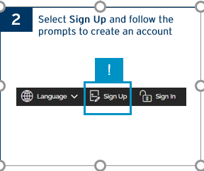

Slide 51
Step 2a: Enter your email

Slide 52
Step 2b: Agree to Terms of Service and Privacy

Slide 53
Step 2c: Check your inbox (including Spam or junk folder)

Slide 54
Step 2d: Copy Security Token

Slide 55
Step 2e: Enter Security Token

Slide 56
Step 2f: Create Account – Additional Information

Slide 57
Step 2g: Account Creation Successful – Select Login

Slide 58
Step 2h: Select Sign in

Slide 59
Step 2i: Enter Email and password to sign in

Slide 61
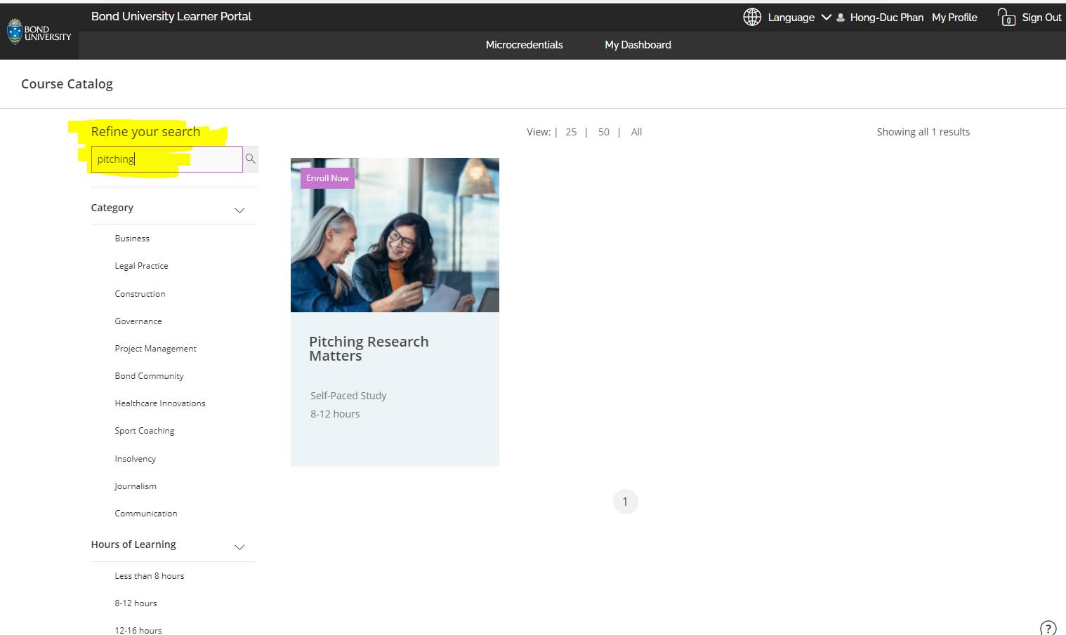

Slide 65
Step 5a: Read Course Overview

Slide 66
Step 5b: Watch the Intro video

Slide 67
Step 5c: Go to “My Dashboard”

Slide 68
Step 5d: Select “Continue Course”

Slide 69
Step 5e: Get Started!

Slide 70
How? … “sign-posting” the course structure

Slide 72
Module 1 – Pitching Research Framework

Slide 73
Module 1 Pitching Research Framework – 7 lessons

Slide 74
Module 1 Pitching Research Framework – end of module

Slide 75
Module 1 – Revision Quiz

Slide 76
Module 2 – Some Basic guidance on pitching

Slide 78
Module 2 – Basic guidance on pitching – 5 lessons

Slide 79
Module 2 – Basic guidance on pitching – Revision Quiz

Slide 80
Module 3 – Alternative types of pitching

Slide 81
Module 3 – Alternative types of pitching – Start Module

Slide 82
Module 3 – Alternative types of pitching – 7 lessons

Slide 83
Module 3 – Alternative types of pitching – Revision Quiz

Slide 84
Overall MC FINAL QUIZ

Slide 85
Overall MC … Congratulations!

Slide 86
Overall MC … Click “CERT” icon to download Bond U Certificate

